Slide 1




MENTOR TALKS
Ngobrol topik santai tentang AI bareng mentor dan member di telegram

Slide 2

Tentang Komunitas Indonesia AI
Bertumbuh Bersama Komunitas
Mari bergabung bersama ribuan lebih para pembelajar dan praktisi AI lainnya di komunitas Indonesia AI!
We are a community
Komunitas Indonesia AI berkomitmen untuk mengadakan program-program menarik dan tanpa biaya yang mengangkat ragam topik di dunia AI. Kamu juga bisa bertemu dengan para mentor kami di komunitas ini. Dari komunitas untuk komunitas.
We are a community, together we can!

Slide 3

Benefits
Networking
Collaboration
Berkenalan dengan para member lainnya melalui ragam program hingga event rutin yang diadakan.
Kamu akan memiliki kesempatan untuk berkolaborasi bersama untuk mengadakan event yang mengundang para ahli AI di Indonesia.
Troubleshooting
Merasa sulit ketika coba buat AI sendiri? Kamu bisa coba konsultasikan masalah yang kamu hadapi ke para mentor kami atau member lainnya.
Inspiration
Kami percaya kalau kamu bergerak bersama kamu bisa mendapatkan banyak inspirasi untuk hal yang tengah kamu lakukan dengan teknologi AI, termasuk informasi karir.

Slide 4
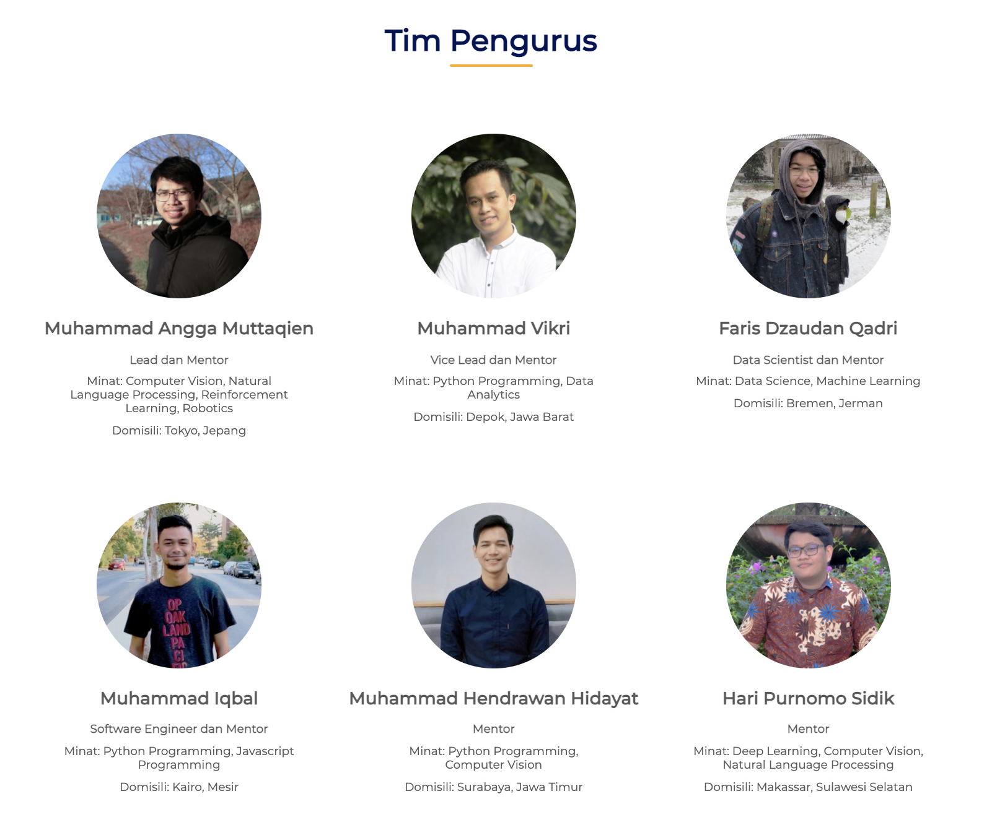
Tim Pengurus
Registered members
Komunitas Indonesia AI terdiri dari pengurus inti dan para anggota yang teregistrasi sebanyak lebih dari 1000 members termasuk kamu!
Open Recruitment
Kedepan kami akan buka program Open Recruitment Pengurus Komunitas Indonesia AI 2021/2022, stay tuned terus yah!

Slide 5
Networking Session
Sesi networking (10 menit)
Yuk silahkan para member bisa memperkenalkan dirinya dulu :)

Slide 6
Python Data Structures Comprehension

Slide 7
Python Data Structures
Tuple
List
Dict
Set

Slide 8
Tuple
What is tuple?
“A Tuple is a fixed-length, immutable sequences of Python objects.“
How to create tuple?
tup = 1, 2, 3, 4
tup = (1, 2, 3, 4)
# Nested Tuple
tup = (1, 2), (3, 4)
Convert any data types to tuple
tuple([1, 2, 3]
tup = tuple(“String”)
> (‘S’, ’t’, ’r’, ’i’, ’n’, ’g’)

Slide 9
Tuple
Modify mutable elements in Tuple
tup = tuple(['foo', [1, 2], True])
tup[1].append(3)
> (['foo', [1, 2, 3], True])
Unpacking Tuple
tup = (1, 2, 3)
a, b, c = tup
# Nested tuple
tup = (1, 2, 3, (4, 5))
a, b, c, (d, e) = tup

Slide 10
Tuple
Example Unpacking Tuple
seq = [(1, 2, 3), (4, 5, 6), (7, 8, 9)]
for a, b, c in seq:
print(f"a={a}, b={b}, c={c}")
*Rest
values = (1, 2, 3, 4, 5)
a, b, c, *rest = values
Tuple’s Count Method
Counts the number of occurrences of a value, this is also available on list values = (1, 2, 3, 4, 5)
values.count(2)

Slide 11
List
What is List?
“In contrast with tuples, lists are variable-length and their contents can be modified”
Create list
a_list = [1, 2, 3, None]
b_list = list((1, 2, 3, 4, 5))
a = list(range(1, 10))
Adding Elements
# using append
my_li = [1, 2, 3, 4, 5, 6]
my_li.append(7, 8, 9)
# using insert
my_li.insert(1, "Hello")

Slide 12
List
Removing elements
b_list = [1, 2, 3, 4, “Good”]
b_list.pop(1)
b_list.remove(“Good”)
Checking whether a list contains a specified value
"Good" in b_list
Extending lists
x = [4, None, 'foo']
y = ["Good", "Hello"]
x.extend[y]

Slide 13
List
Sorting
a = [7, 2, 5, 1, 3]
a.sort()
# Sorting String
b = ['saw', 'small', 'He', 'foxes', 'six']
b.sort(key=len)
Binary Search
Binary search finds the location where an element should be inserted in the sorted list to keep it sorted
import bisect
c = [1, 2, 2, 2, 3, 4, 7]
bisect.bisect(c, 10)

Slide 14
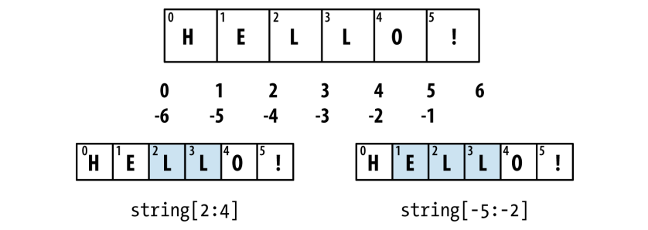
List
Insort
Insert an sorted list into suitable location
c = [1, 2, 2, 2, 3, 4, 7]
bisect.insort(c, 0)
Slicing

Slide 15
Built-in Sequence Function
Enumerate
Iterating over sequence to want to keep track of the index of the current item
for i, value in enumerate(collection):
# lakukan sesuatu
Sorted
Returns a new sorted list from the elements of any sequence
sorted([7, 1, 2, 6, 0, 3, 2])
# For String
sorted('Indonesia.ai')
['.', 'I', 'a', 'a', 'd', 'e', 'i', 'i', 'n', 'n', 'o', 's']

Slide 16
Built-in Sequence Function
Zip
Pairs up the elements of a number of lists, tuples, or other to create a list of tuples
seq1 = ['foo', 'bar', 'baz']
seq2 = ['one', 'two', 'three']
zipped = zip(seq1, seq2)
Other usage
for i, (a, b) in enumerate(zip(seq1, seq2)):
print(f"{i}: {a}, {b}")
Unzip sequence
pitchers = [('Nolan', 'Ryan'), ('Roger', 'Clemens'), ('Schilling', 'Curt')]
first_name, last_name = zip(*pitchers)

Slide 17
Built-in Sequence Function
Reversed
Iterates over the elements of a sequence in reverse order
li = reversed(range(10))
list(li)

Slide 18
Dict
What is Dict
“Flexibly sized collection of key-value pairs, where key and value are Python objects. Also called with hash map or associative array.”
Creating Dict
d1 = {'a' : 'some value', 'b' : [1, 2, 3, 4]}
Checking if a dict contains a key using the same syntax used for checking whether a list or tuple contains a value
'b' in d1
Deleting values
del dt[key]
d1.pop('<values>')

Slide 19
Dict
Keys Method
Return keys from the dict
d1.keys()
Values Method
Return values from the dict
d1.values()
Merge one dict into another
d1.update({'b' : 'foo', 'c' : 12})
Creating dicts from sequences
mapping = {}
for key, value zip(key_list, values_list):
mapping[key] = value

Slide 20
Dict
Other way
mapping = dict(zip(range(10), reversed(range(10))))
Default Values
Can written like:
if key in some_dict:
value = some_dict[key]
else:
value = default_value
Can be written simply like:
value = some_dict.get(key, default_value)

Slide 21
Dict
Categorizing a list of words by their first letter as dict
words = ['Kelelawar', 'Apel', 'Atom', 'Truk', 'Komputer', 'Ayam']
new_dict = {}
for word in words:
key = word[0]
if key not in new_dict:
new_dict[key] = [word]
else:
new_dict[key].append(word)
More simple?
for word in words:
key = word[0]
new_dict.setdefault(key, []).append(word)

Slide 22
Dict
More?
from collections import defaultdict
new_dict = defaultdict(list)
for word in words:
new_dict[word[0]].append(word)

Slide 23
Set
What is set?
“Set is an unordered collection of unique elements. Set like dicts, but keys only, no values.”
How to create set?
set([2, 2, 2, 1, 3, 3])
my_set = {1, 2, 3, 4, 5}
Set method
Set support mathematical set operation like union, intersection, difference, and other
a = {1, 2, 3, 4, 5}
b = {3, 4, 5, 6, 7, 8}
a.union(b)

Slide 24
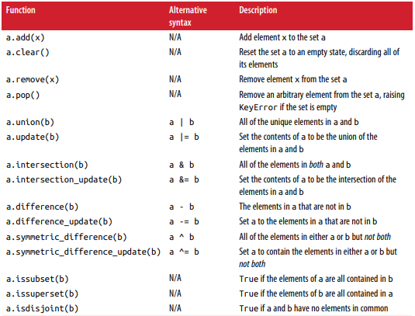
Set

Slide 25
List Comprehensions
List comprehensions are one of the most-loved Python language features. They allow us to concisely form a new list by filtering the elements of a collection. They take the basic form like:
[expr for val in collection if condition]
Equivalent with:
[expr for val in collection if condition]
result = []
for val in collection:
if condition:
result.append(expr)

Slide 26
List Comprehensions
Example
strings = ['a', 'as', 'bat', 'car', 'python']
new_strings = [x.upper() for x in strings if len(x) > 2]
text = "Indonesia.Ai"
strings = [x for x in text]

Slide 27
List Comprehensions
Nested List Comprehensions
Before:
all_data = [['John', 'Emily', 'Michael', 'Mary', 'Steven'],['Maria', 'Juan', 'Javier', 'Natalia', 'Pilar']]
names_of_interest = []
for names in all_data:
results = [name for name in names if name.count('e') >= 2]
names_of_interest.extend(results)
After:
result = [name for names in all_data for name in names if name.count('e') >= 2]

Slide 28
List Comprehensions
Other example
some_tuples = [(1, 2, 3), (4, 5, 6), (7, 8, 9)]
result = [[x for x in tup] for tup in some_tuples]

Slide 29
Set Comprehensions
Basic form
set_comp = {expr for value in collection if condition}
Example:
strings = ['a', 'as', 'bat', 'car', 'dove', 'python']
unique_lenth = {len(x) for x in strings}
More short
set(map(len, strings))

Slide 30
Dict Comprehensions
Basic forms
dict_comp = {val : index for index, val in enumerate(collection)}
Example:
strings = ['a', 'as', 'bat', 'car', 'dove', 'python']
unique_lenth = {len(x) for x in strings}
More short
set(map(len, strings))

Slide 31
Dict Comprehensions
Other examples
profile_form = ["Nama", "Alamat"]
data = ["Muhammad Iqbal", "Darosah"]
new_dict = {key : value for key, value in zip(profile_form, data)}
profile = ["Nama", "Alamat"]
data = [["Muhammad Iqbal", "Budi"], ["Darosah", "Asher"]]
new_dict = {key : [value for value in values] for key, values in zip(profile, data)}

Slide 32

Our Channel
Find us on Youtube

Slide 33

Terima Kasih!
Indonesia AI | AI for Everyone, AI for Indonesia
contact@aiforindonesia.org

